Slide 1
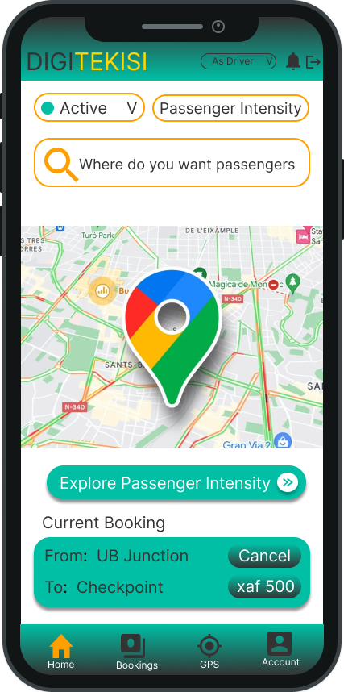

Welcome To DIGITEKISI
Where all your navigation problems are resolved

Slide 2

What started as barely an Idea!

Slide 3
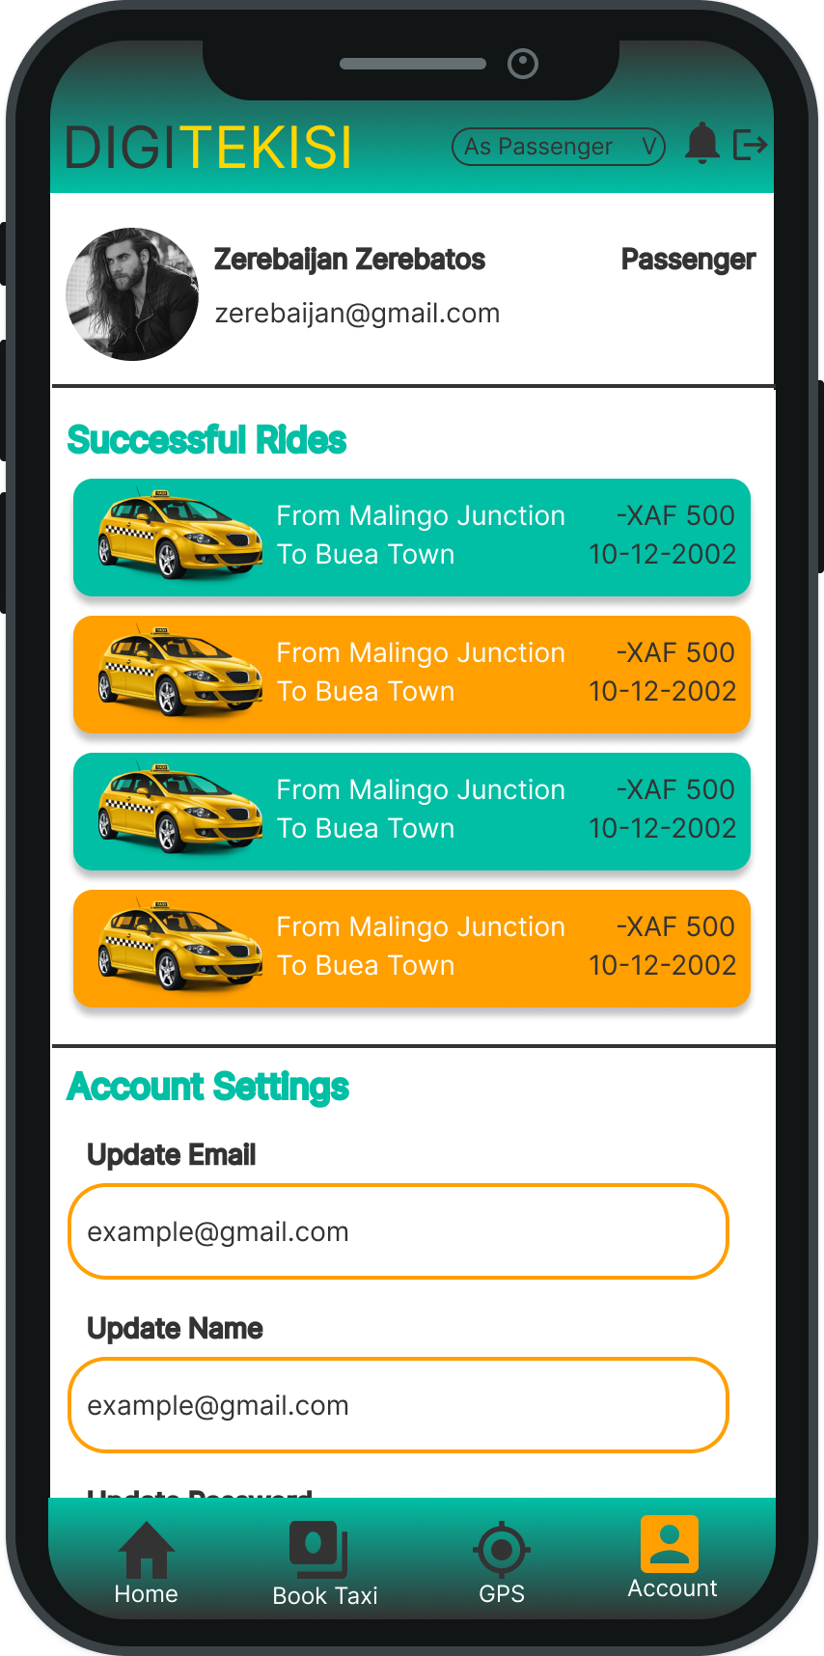
Quickly became an MVP ready for testing

Slide 4

We are here to walk you through our process. Let us ride along!

Slide 5
Overview of Presentation
1
2
3
4
Idea Generation and Planning
Development
What do we plan on doing and how?
How we got from idea to product
Pitfalls and how we overcame
Conclusion
What do we make of all these?
What are some of the pitfalls we faced? How did we come out on top

Slide 6

1
Idea Generation and Planning

Slide 7
This entire process involved the following steps
1
2
3
Preparation
Incubation
Ideation
Involves gathering information, researching, and defining the challenge that you want to solve
Dwelling on ideas to come up with something substantial
Involves generating and evaluating potential solutions

Slide 8

2
Development

Slide 9
Overview of Development Process
1
2
3
4
Analysis of Design
System & UI Design
Implementation of UI and Database
Testing and Deployment

Slide 10
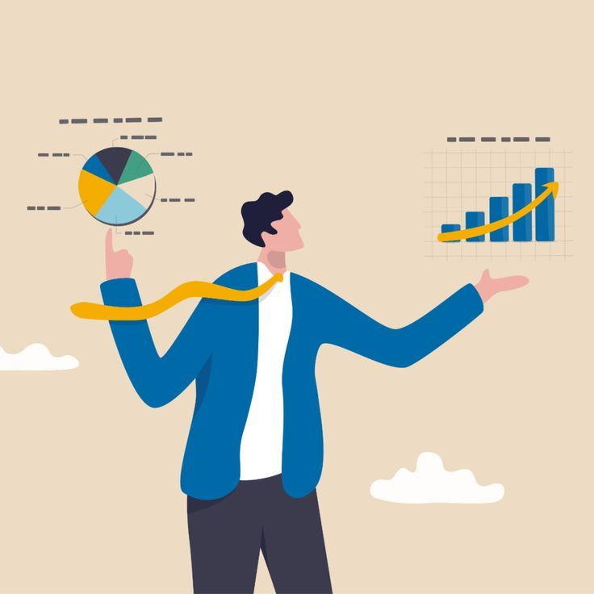
1
Analysis and Design

Slide 11
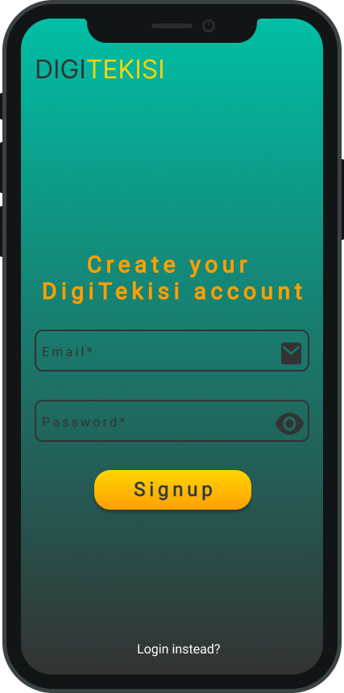
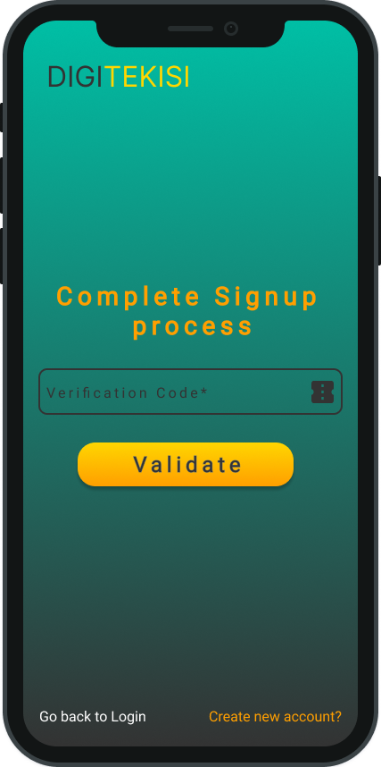
2
System and UI Design

Slide 12

3
Implementation of UI and Database

Slide 13
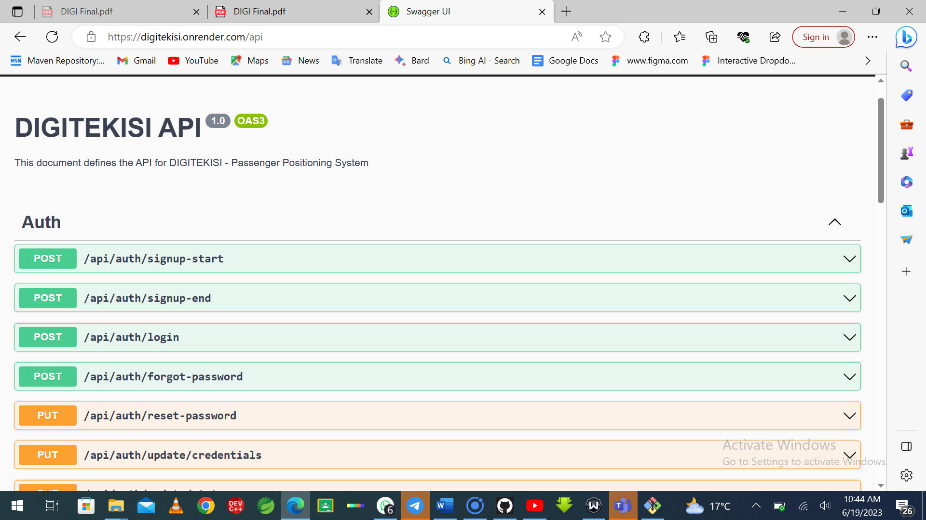
API Documentation

Slide 14

4
Testing and Deployment

Slide 15
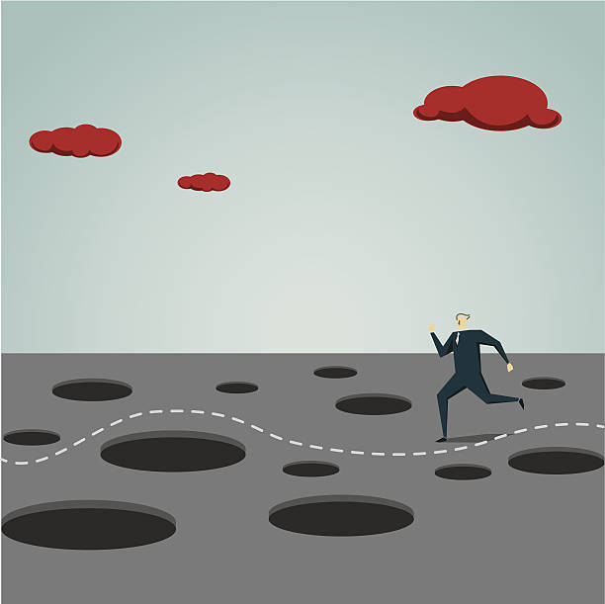
3
Dealing With Pitfalls

Slide 16
Some Pitfalls faced during process
1
2
3
4
Difficulty working with React Native
Insufficient synergy between frontend and backend team
Uneven experience in different technologies
No foreign key implementation in Planet Scale

Slide 17
How we overcame them!
1
2
3
4
Used React in place of React Native
Used Swagger Documentation
Placed member on team that matched their skill
Used Supabase and Postgres in place of Planetscale and MySql

Slide 18
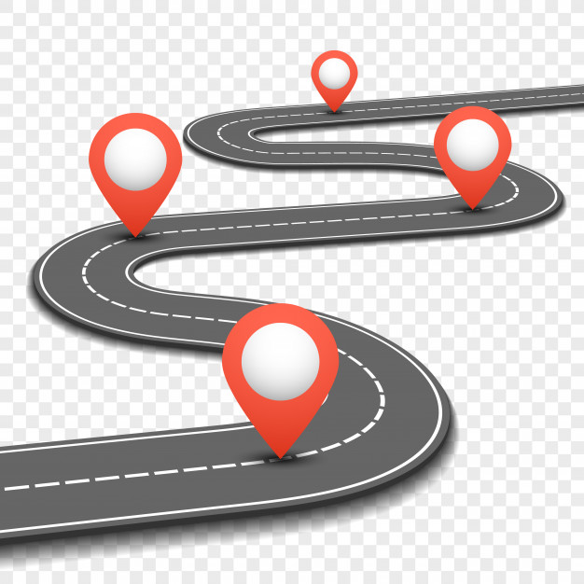
4
Conclusion

Slide 19
"Developing a mobile app is a journey that requires a combination of creativity, technical expertise, and perseverance. Along the way, there will be pitfalls and challenges to overcome, but with careful planning, diligent execution, and a commitment to quality, the end result can be a truly transformative product that delights users and delivers tangible value to the world."

Slide 20
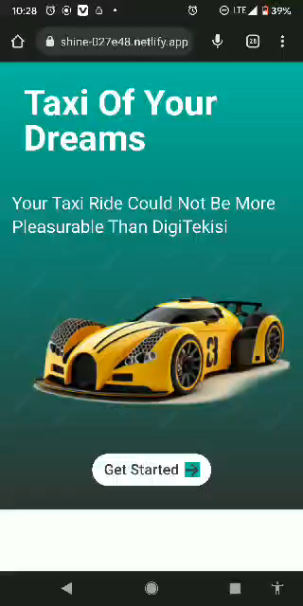
Demo

Slide 21
THANK
YOU

